Slide 1





ICCSP ’24
10th International Conference on Communication and Signal Processing
EXPLORING THE PATH: MACHINE LEARNING APPROACHES TO CARDIOVASCULAR RISK ASSESSMENT
PAPER ID: 1570999732

Slide 2
AUTHORS
01
04
NagaCharitavaya Madala
Venkata Sikari Malladi
02
05
Sai Durga Saradhi Pranu Deepak Tallapudi
Murali Krishna Enduri
03
06
Mahitha Chimata
Srilatha Tokala

Slide 3

TABLE OF CONTENTS
01
Introduction
02
Dataset Statistics
03
Methodology
04
Result Analysis
05
Conclusion and Future Work
06
References

Slide 4


INTRODUCTION
Our research explores the utilization of machine learning algorithms and hybrid algorithm techniques for predicting Cardiovascular Risk Assessment by using two distinct datasets, namely the heart dataset and the Framingham dataset.
Our study delves into the potential of machine learning to enhance the accuracy and efficiency of cardiovascular risk prediction. By employing advanced computational methods.
Our research aims to enable early identification of individuals at risk, enabling timely interventions and personalized treatment strategies to mitigate cardiovascular diseases.

Slide 5

DATA SET STATISTICS
Heart Dataset
Framingham Datase﻿t
- Source: Kaggle
- File: "heart.csv"
- Instances: 303
- Attributes: 14 (13 numerical)
- Class Attribute: "target" (1=present,0= absent)
- Missing Values: None
- Data Integrity: No missing/null values
- Source: Kaggle
- File: "framingham.csv"
- Instances: 3658 (initially 4240)
- Attributes: 16 (15 numerical)
- Binary Classification: "TenYearCHD"
(0 = low risk, 1 = high risk)
- Initial Missing Values: 645 null values (13% of total data)
- Data Integrity: No missing or null values after removal

Slide 6
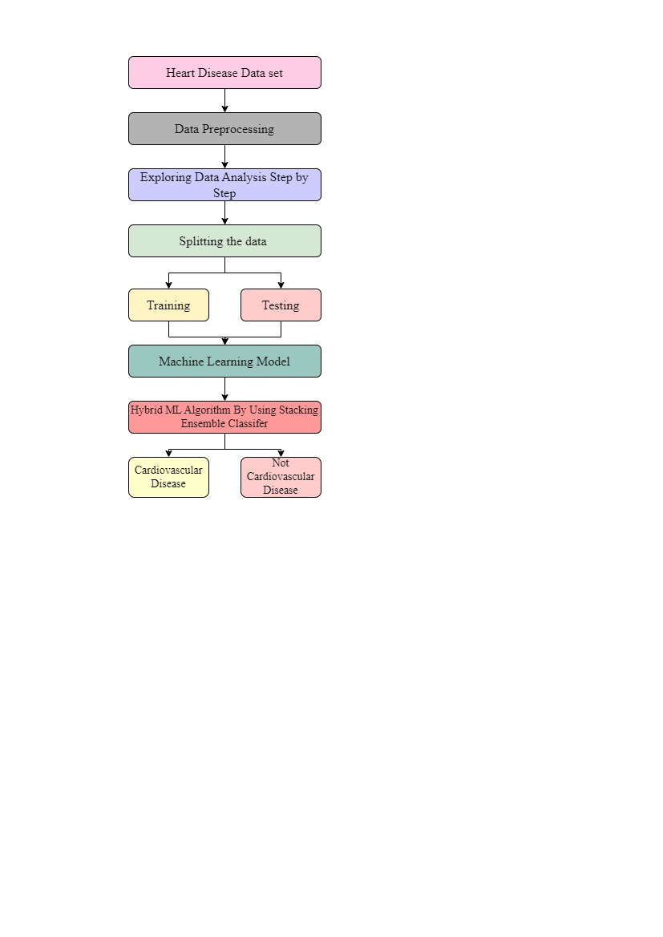

METHODOLOGY
For cardiovascular risk assessment, we adopted this approach by leveraging both heart and Framingham datasets.
Data Collection: Obtained from Kaggle- Both datsets
Data Preprocessing:
Handle missing values: Impute missing values using appropriate techniques such as mean, median, or predictive modeling.
Normalize or standardize numerical features to ensure uniform scale across variables.

Slide 7
Implementation of Algorithms:
Machine Learning Algorithms : -
Logistic Regression,Naive Bayes,K-nearest neighbor,Decision Tree,Random Forest,Gradient Boosting Machine,XGBoost,ADABoost,Support vector Machine,Principal Component Analysis
Hybrid Algorithms :- GBM+DT,LR+PCA,GA+SVM,AD+SVM,RT+GBM
Algorithm Performances:
For Heart Dataset
For Framingham Dataset
ML Accuracies ranged from 67% to 90%
ML Accuracies ranged from 72% to 83%
Hybrid Model Accuracies ranged from 83% to 93.5%
Hybrid Model Accuracies ranged from 89% to 93.5%

Slide 8

The machine learning framework incorporates a range of models, discussed in this section.
Moreover, the framework features hybrid algorithms that amalgamate the strengths of individual models. The GBM-DT hybrid combines Decision Trees' interpretability with gradient-boosting predictive ability. To improve classification, PCA-LR uses Principal Component Analysis to reduce dimensionality, followed by Logistic Regression. GA-SVM uses Genetic Algorithms to optimize Support Vector Machine parameters, which improves performance. AdaBoost-SVM uses AdaBoost ensemble learning to enhance SVM's predictive capabilities .
Finally, RF-GBM combines the advantages of Random Forest and Gradient Boosting into an ensemble model. Preprocessing steps specific to each model performance evaluation using relevant metrics are all emphasized in the implementation guidelines.

Slide 9

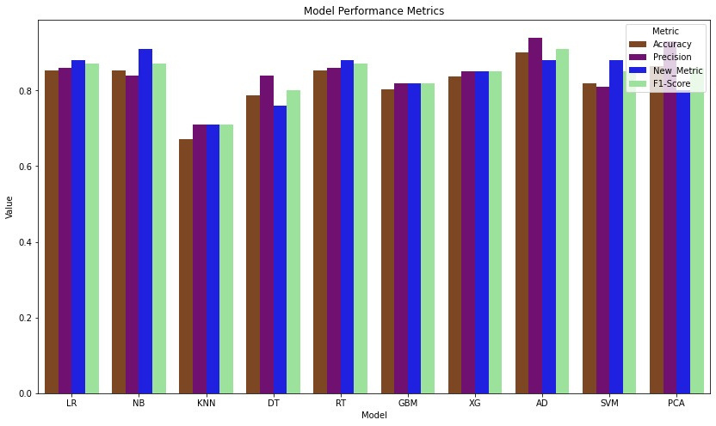
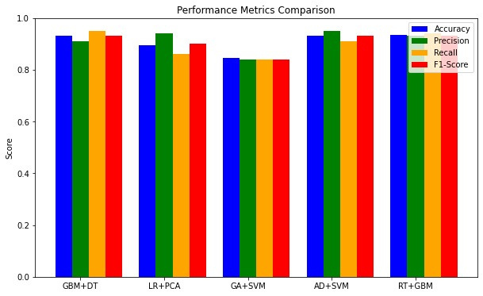
RESULT ANALYSIS
It shows the performance measures of different models performed for algorithms in ‘heart.csv’ dataset. It is observed in the figure that for all the performance measures ADA Boost algorithm performs well compared to the other algorithms. The least performance is given by the KNN Algorithm
It demonstrates the performance of hybrid algorithms used in our analysis. It is observed in the analysis that ADA Boost combined with SVM method gives better performance that all the remaining algorithms. The least performance is given by the genetic algorithm and SVM methods.

Slide 10
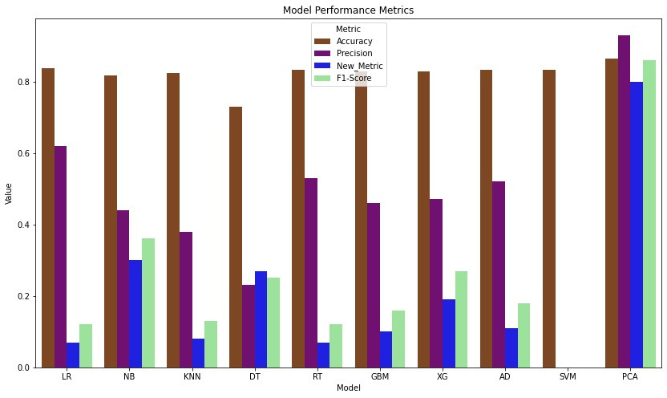
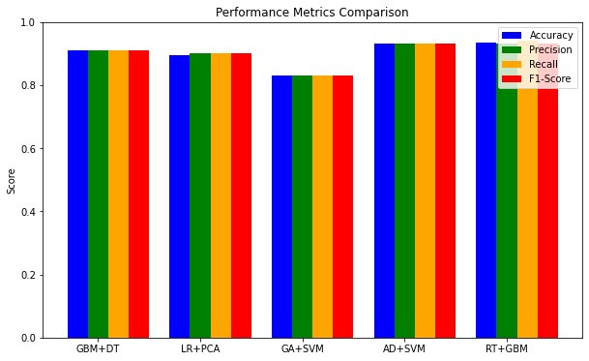
It shows the performance measures of different models performed for algorithms in ‘framingham.csv’ dataset. It is observed in the dataset that PCA method gives better performance than all the remaining methods. The least performance for the accuracy and precision measures is given by the decision tree method, and the random forest method gives the less score for the recall and F1-score method.
It demonstrates the performance measures of different models performed for hybrid algorithms in the ‘framingham.csv’ dataset. It is observed in the dataset that the hybrid method for decision tree and gradient boosting method gives better performance than all the methods. The least performance is shown by the hybrid method genetic algorithm and SVM

Slide 11

CONCLUSION AND FUTURE WORK
Our study establishes Random Forest (RF) and Gradient Boosting Machine (GBM) as superior models, surpassing others and hybrid approaches with an accuracy rate of 93.5%. Their iterative and ensemble optimization methods effectively handle dataset complexities, solidifying their status as formidable predictive modeling tools.
RF and GBM excel in recognizing intricate data relationships and accommodating diverse patterns, making them optimal choices for maximizing accuracy within our research scope. Additionally, our comprehensive methodology, considering all variables, enhances predictability, bolstering both accuracy and reliability.
Future research should focus on enhancing scalability for RF and GBM to handle larger datasets and improving model interpretability. Investigating advanced ensemble techniques and hybrid models could further enhance predictive capabilities.
Expanding analyses to incorporate diverse data sources or domain-specific insights could deepen our understanding and lead to more tailored models. In summary, refining methodologies and exploring new avenues will address evolving challenges in predictive modeling.

Slide 12

REFERENCES
[1]. A. S. Abdullah and R. R. Rajalaxmi, ‘‘A data mining model for predicting the coronary heart disease using random forest classifier,’’ in Proc. Int. Conf. Recent Trends Compute Methods, Commun. Controls, Apr. 2012, pp. 22–25.
[2]. N. Al-milli, ‘‘Back Propagation neural network for prediction of heart disease,’’ J. Theor. Appl.Inf. Technol., vol. 56, no. 1, pp. 131–135, 2013.
[3]. C. A. Devi, S. P. Rajamohanan, K. Umamaheswari, R. Kiruba, K. Karunya, and R. Deepika, ‘‘Analysis of neural networks based heart disease prediction system,’’ in Proc. 11th Int. Conf. Hum. Syst. Interact. (HSI), Gdansk, Poland, Jul. 2018, pp. 233–239.
[4]. Mourão-Miranda, J., Bokde, A.L.W., Born, C., Hampel, H., Stetter, M.: Classifying brain states and determining the discriminating activation patterns: support vector machine on functional MRI data. Neuroimage 28(4), 980–99
[5]. S. Mohan, C. Thirumalai and G. Srivastava, "Effective Heart Disease Prediction Using Hybrid Machine Learning Techniques," in IEEE Access, vol. 7, pp. 81542-81554, 2019, doi: 10.1109/ACCESS.2019.2923707.
[6]. Doppala, Bhanu Prakash, et al. "A hybrid machine learning approach to identify coronary diseases using a feature selection mechanism on a heart disease dataset." Distributed and Parallel Databases (2021): 1-20.
[7]. Almulihi, Ahmed, et al. "Ensemble Learning Based on Hybrid Deep Learning Model for Heart Disease Early Prediction." Diagnostics 12.12 (2022): 3215.

Slide 13


